Slide 1
1010CG submission options
Office of the Chief Technology Officer
July 2022
FOR INTERNAL USE ONLY

Slide 2
Context
1010CG submission options
Objectives:
Provide users with accurate and useful messaging
Increase form submissions success rate
Significant increase in submission volume expected >= 10/1
High profile program with specific sensitivities around benefits and status of benefits

Slide 3
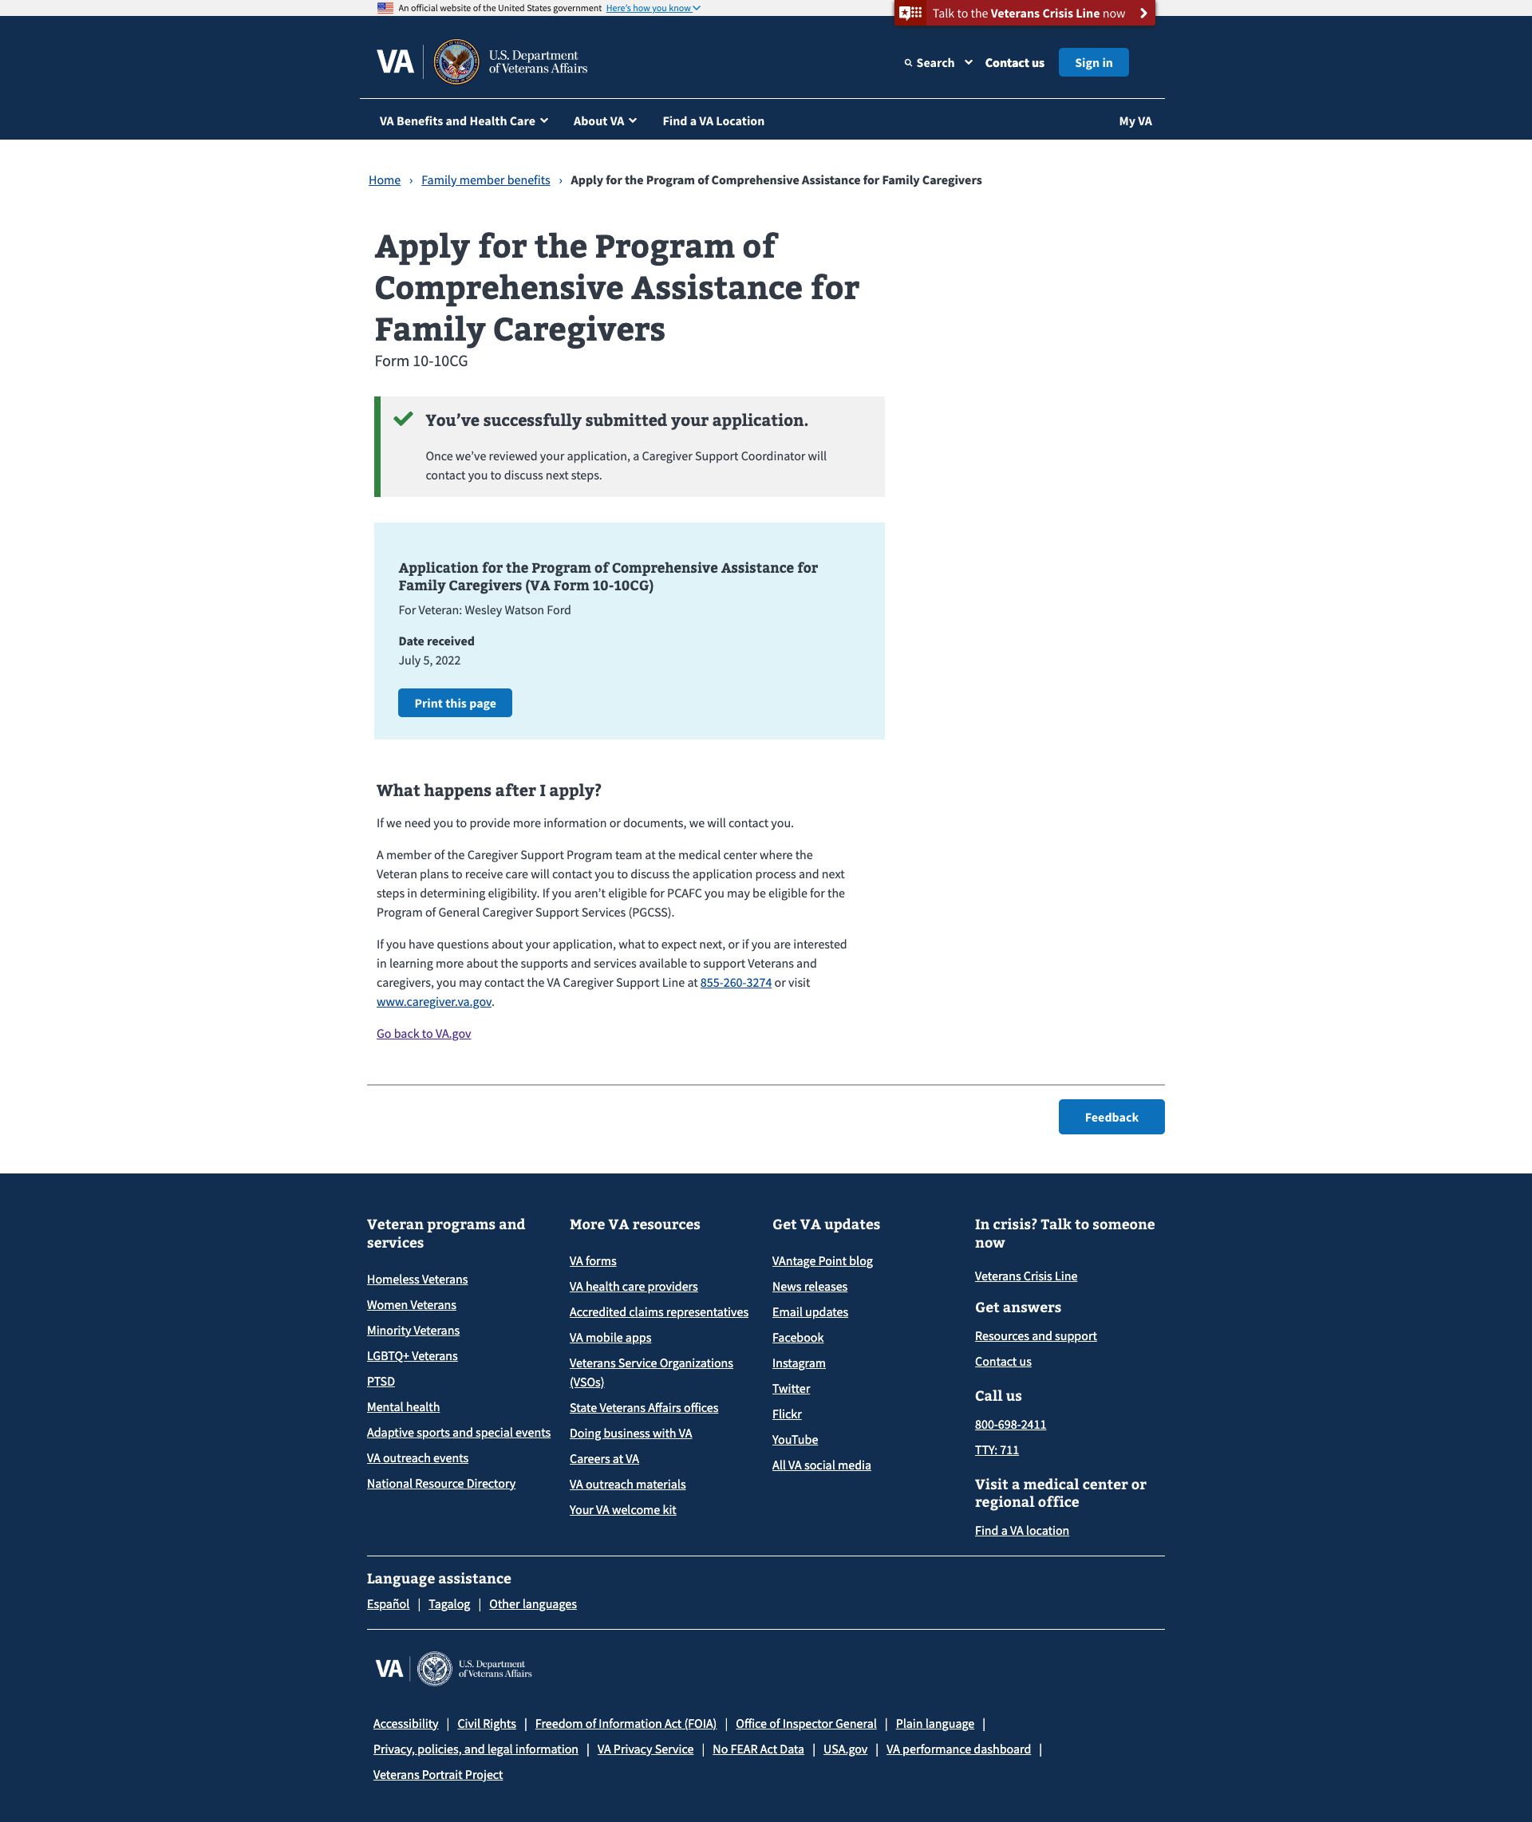
Current state
1010CG submission options
On submit:
If 2xx is received from MuleSoft, success message.
If non-2xx is received from MuleSoft, failure message and option to download PDF for manual submission.

Slide 5
Options
1010CG submission options
Option 1: Communicate submission outcome from vets-api
Option 2: Communicate submission outcome from MuleSoft

Slide 6
Option 1: Communicate submission outcome from vets-api

Slide 7
Communicate submission outcome from vets-api
1010CG submission options: Option 1
Retain current messaging, but change basis for messaging
Message based on response received from vets-api
If form is received, validated, stored, and processed by vets-api, message is “submission successful”
If form is not received, validated, stored, or processed by vets-api, message is “there was an issue…”
User is shielded from any technical issues that might arise beyond vets-api

Slide 8
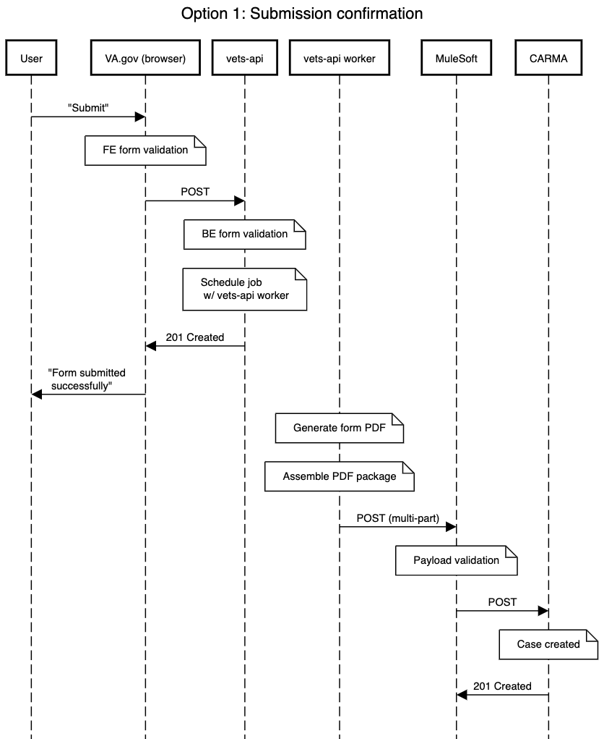
1010CG submission options: Option 1

Slide 9
1010CG submission options: Option 1
Failures here impact user experience

Slide 10
Option 2: Communicate submission outcome from MuleSoft

Slide 11
Communicate submission outcome from MuleSoft
1010CG submission options: Option 2
New, differential messaging based on MuleSoft outcome
Message is based on response received from MuleSoft
If MS creates CARMA case on first try, “success” message
IF CARMA fails on first try, “additional time needed” message
In addition to existing messaging based on vets-api response
e.g., failure to reach MS → “download PDF and mail”

Slide 12
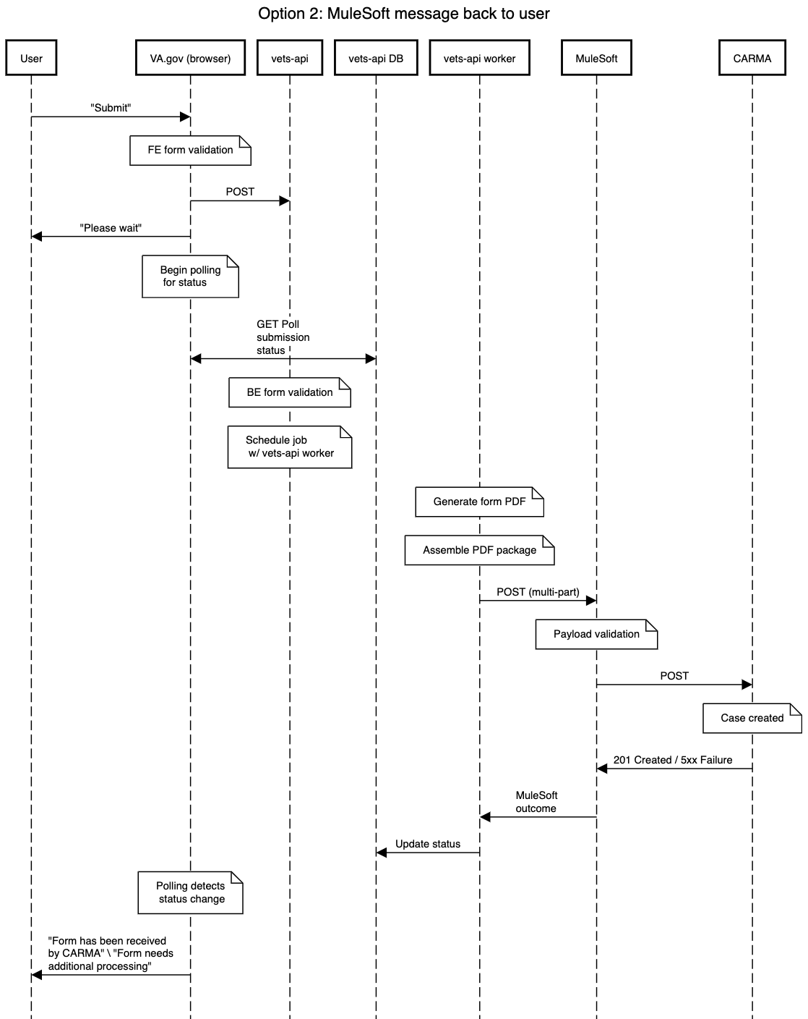
1010CG submission options: Option 2

Slide 13
1010CG submission options: Option 2
Failures here impact user experience

Slide 14
Recommendation
1010CG submission options: Recommendation
Update current messaging to make it further clear that submission status might not be immediately available from contact center
Base message on vets-api outcome to shield user from downstream issues
Implement MuleSoft queue as planned
Implement single payload from vets-api to MuleSoft, executed asynchronously by vets-api worker

